Slide 1
Introduction
CSE 216

Slide 2
Data
Data are individual units of information

Slide 3
Database
A large, integrated, systematic collection of data
For example:
Bank account database
User account database
Etc.

Slide 4
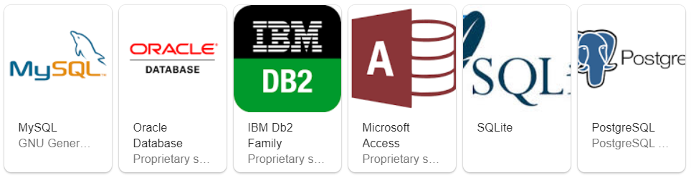
DBMS
DataBase Management System
A piece of software designed to store and manage databases
Example:

Slide 5
Database Terms
In a broad sense

Slide 6
Example Database: IMDB
Table
Movies
Movie_id | Title | Year
1 | Avengers: Endgame | 2019
2 | Avengers: Infinity War | 2018
3 | Spiderman: Homecoming | 2019
… | … | …
Attributes
Records/
Tuples
Columns

Slide 7
Example Database: IMDB
Relationship
Actors
Actor_id | First_name | Last_name
1 | Robert | Downey Jr.
2 | Chris | Evans
3 | Mark | Ruffalo
… | … | …
Movies
Movie_id | Title | Year
1 | Avengers: Endgame | 2019
2 | Avengers: Infinity War | 2018
3 | Spiderman: Homecoming | 2019
… | … | …
Appearances
Actor_id | Movie_id | Role
1 | 1 | Ironman
2 | 1 | Captain America
3 | 1 | Hulk
… | … | …

Slide 8
Schema
Blueprint of a database
Design of tables
How tables are related
Oracle has a built-in database schema

Slide 9
Oracle SQL

Slide 10
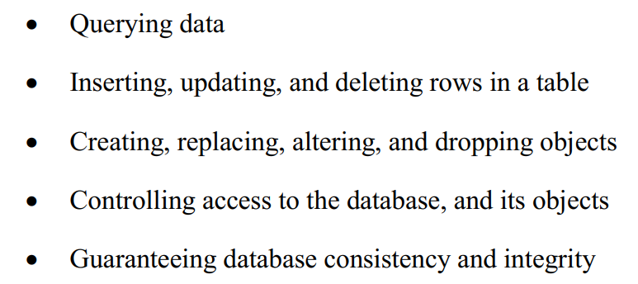
SQL – Structured Query Language

Slide 11
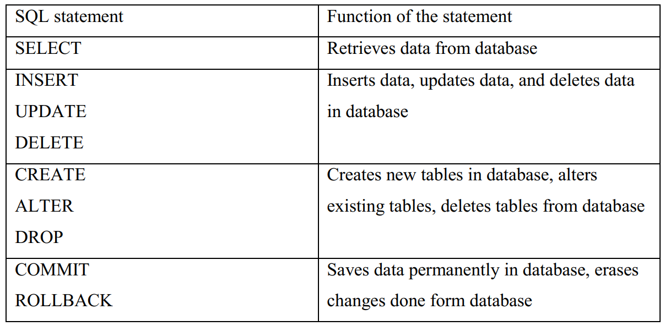
Statements

Slide 12
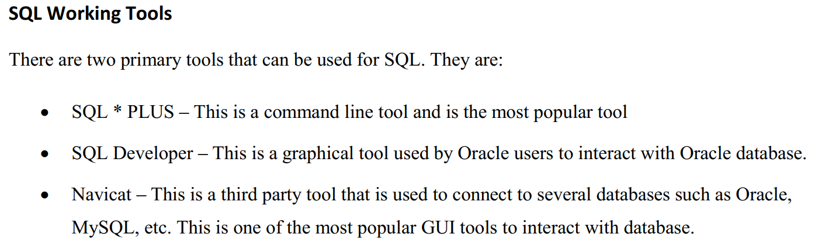

Slide 13
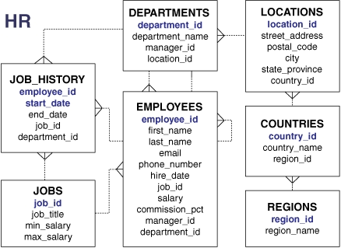
HR Schema
Builtin database schema for learning
Description in text book

Slide 14
SQL Live
https://livesql.oracle.com/apex/f?p=590:1000
https://www.youtube.com/watch?v=4oxsxJQQC-s

